Slide 1
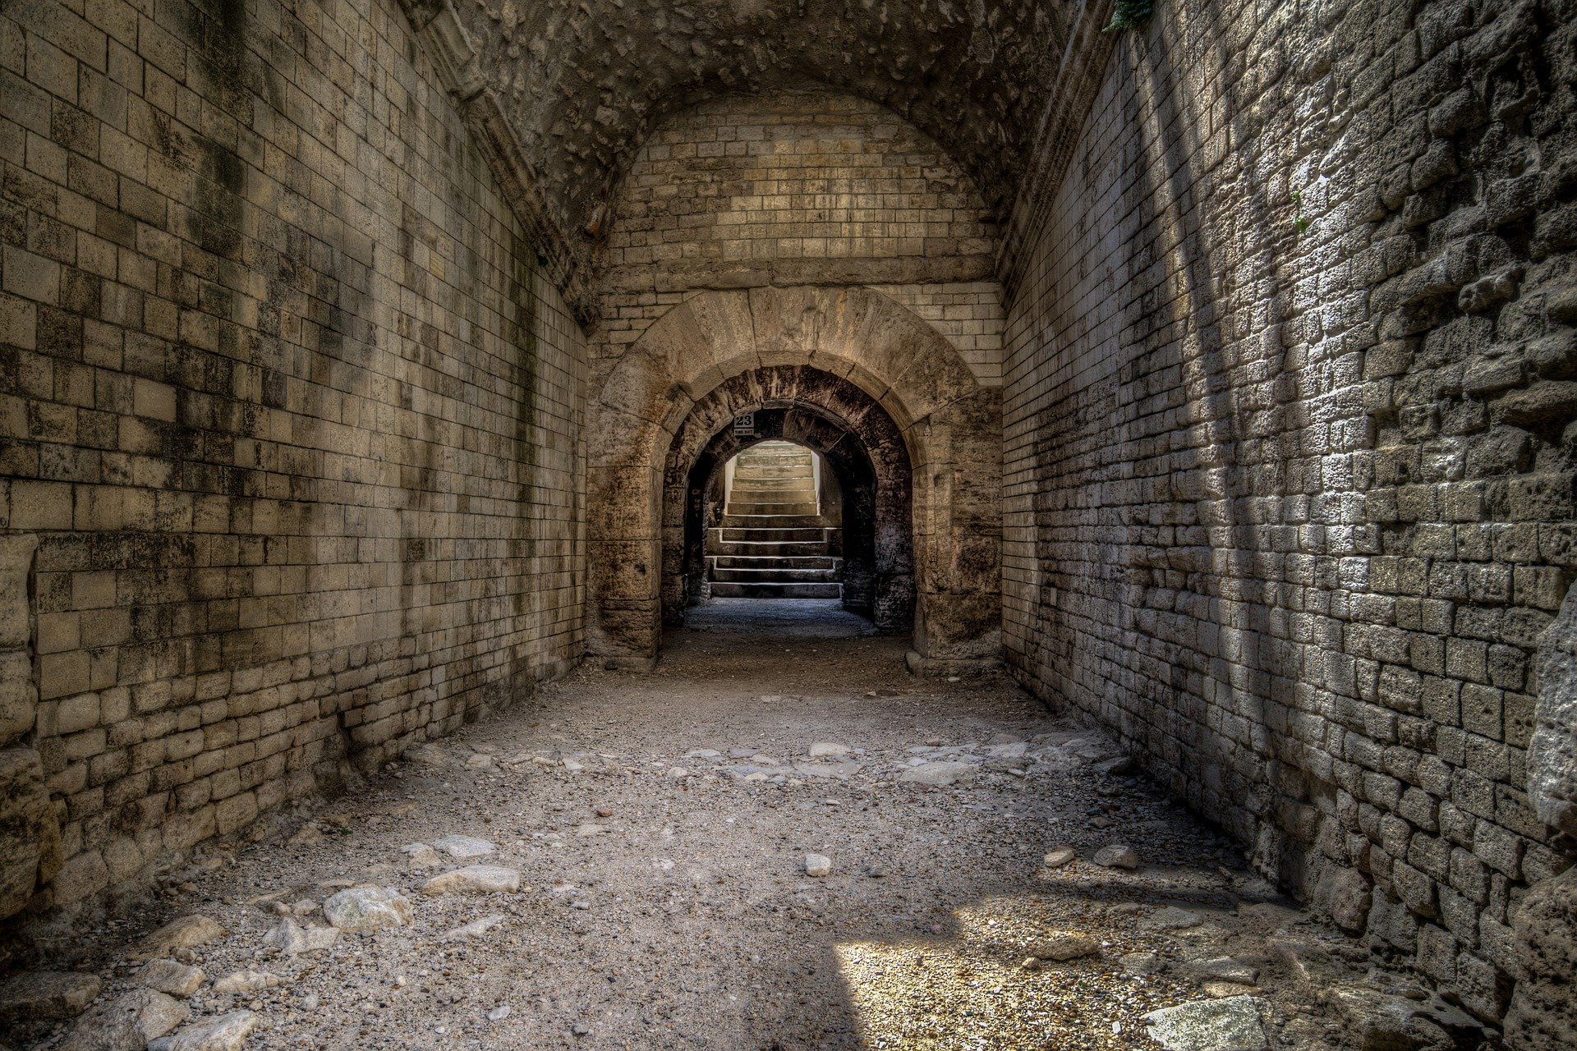

CS Dungeon
by Team Bugatti
CS4900 Senior Seminar
02 / 03 / 2020
Andrew Tucker, Jermy Craven, Kevin Patel, William Lee, Hoyong Lee, Dongwoon Jeong

Slide 2

Contents
CS Dungeon
Members
What is CS Dungeon?
Our Development Tools
Expected Timeline
Budget
Why You should Invest in the Proposal

Slide 3
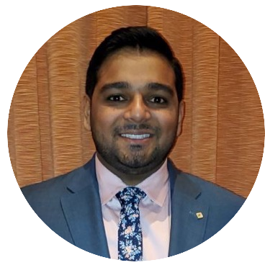
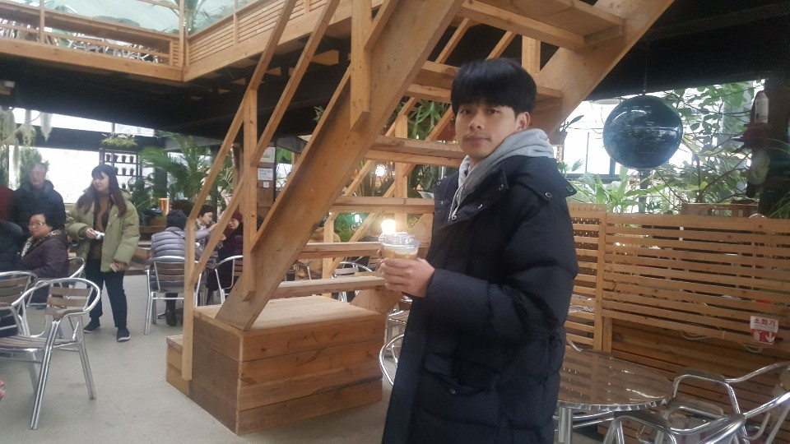
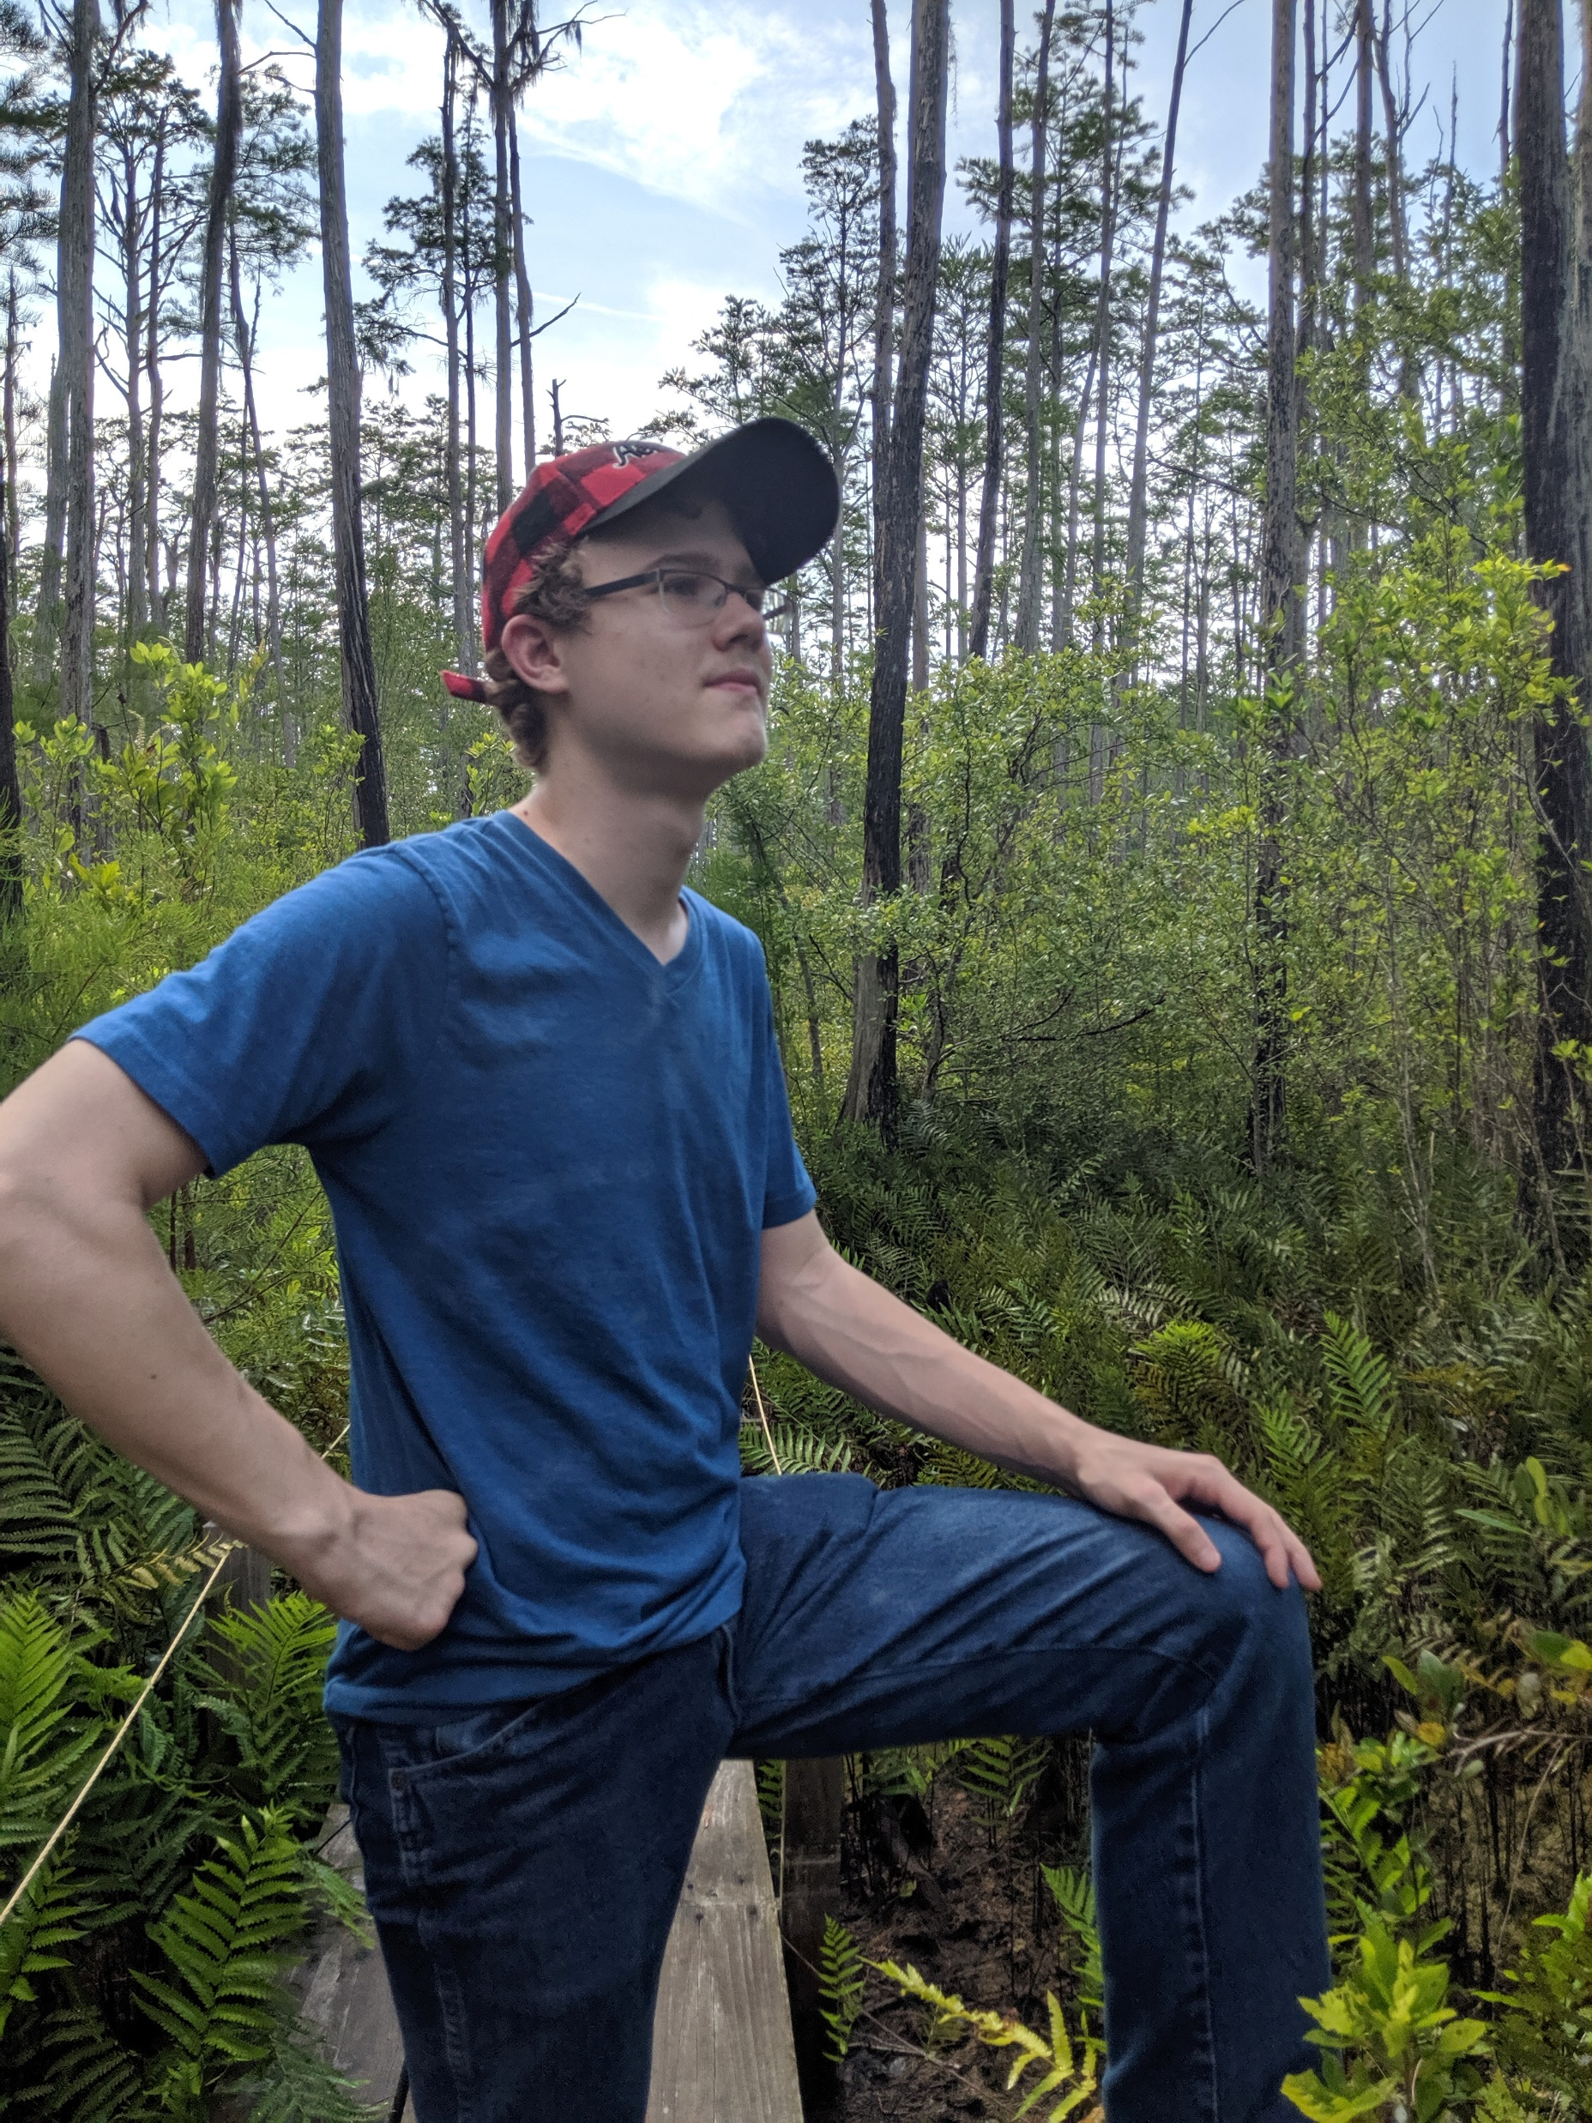
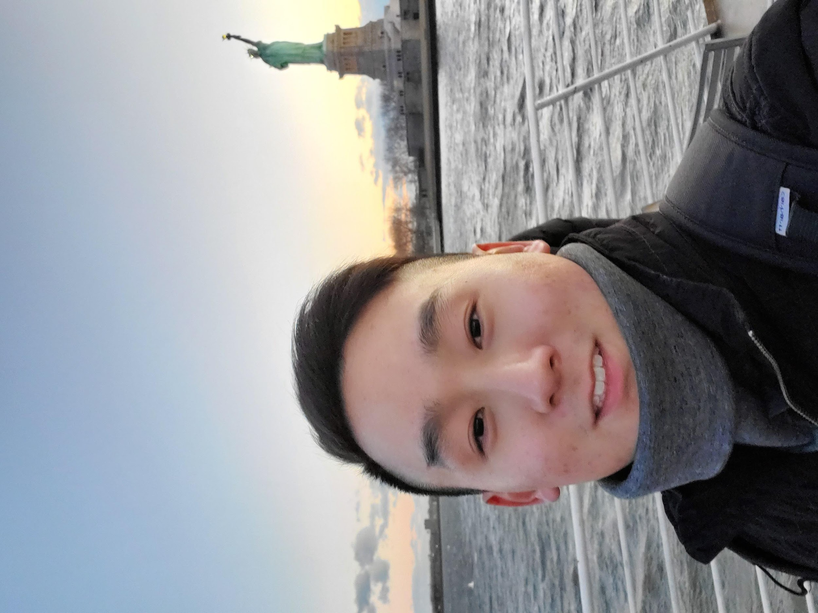
01
Team Bugatti – Members
Jeremy Craven
(Scrum Master)
Senior of computer science.
currently employed as a software engineer at CDK Global marking my software experience mor extensive than others.
C#. Java, C, and Python.
I am expected to graduate December 2020.
William Lee
Senior of computer science major.
I have an experience in java and C
I will be graduating Fall 2020.
Dongwoon Jeong
computer science major in VSU.
Class of 2020
Andrew Tucker
(Product Owner)
Senior of computer science and minor in mathematics.
My skills include java programming, music production, and photoshop.
I should graduate in the spring of 2021.
Hoyong Lee
Senior of computer science major.
I will be graduating on May.
I love my major.
Kevin Patel
computer science major.
I have an experience in java, c, and mySQL coding.
I will be graduating this spring.

Slide 4


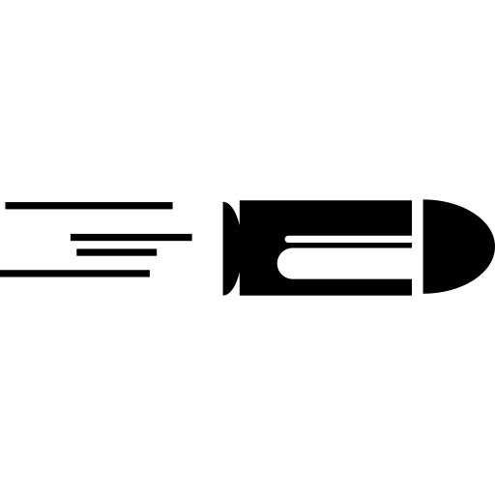

02
CS Dungeon – What is it?
Game like Mega Man where there are levels that you must pass to get to the finish line.
The twist with the game will be that we will make the levels just like the classes we take in CS and you must pass each class to get your degree.
The harder the classes, the more difficult levels will be.
Run & Gun
2D side-scrolling video game
Various Stages
(CS Course)
Various Weapons
Easy to play

Slide 5

03
Our Development Tools
Unity is a cross-platform game engine.
Game engine developed by Unity Technologies, founded in Copenhagen, Denmark, in August 2004.
First announced and released in June 2005 at Apple Inc.'s Worldwide Developers Conference as a Mac OS X-exclusive game engine.

Slide 6

04
Expected Timeline
Jan 31st
Proposal & Website
Feb 3rd – Feb 5th
Research
Feb 12th – March 2nd
Compile Research
Feb 12th – March 2nd
Sprint 1: Art & Characters
March 4th – March 9th
Look over everything
Before Sprint 2
March 11th – April 10th
Sprint 2:
Background Assert
April 13th – April 20th
Look over
everything
April 20th – April 29th
Prepare final
project to Present
We are currently here

Slide 7

05
Why You Should Invest
If you are a CS major, this game has a lot of immersion.(Especially VSU Students)
The big feature of this game is that it is not difficult to control the character, so it can be enjoyed easily by any age group.

Slide 8

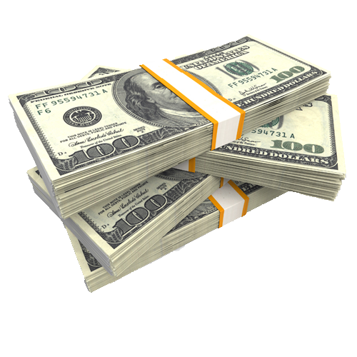
06
Budget
The cost the total cost of this project will be $10,000.
Each staff member will get $35 an hour and each staff is going to spend around 33 hours with the project.
There are 6 staff members the total to that is $6,930.
The other $3,070 will be for the software or hardware and other any overhead cost the team will have.

Slide 9

Question ?

